Slide 1
PRINCIPLES OF INFECTIOUS DISEASE

Slide 2
Infection is the establishment of foreign organisms, or ‘infectious agents’, in or on a human host.
This may result in colonisation, if the microorganism exists at an anatomical site without establishing overt tissue injury, or infectious disease, when the interaction between the host and pathogenic organism (or pathogen) induces tissue damage and clinical illness.

Slide 3
In clinical practice the term ‘infection’ is often used interchangeably with ‘infectious disease’.
Most pathogens are microorganisms, although some are multicellular organisms (parasites).
The interaction between the pathogen and the host is dynamic and complex.

Slide 4
Whilst it is rarely in the organism’s interest to kill the host (on which it relies for nutrition and protection), the generation of disease manifestations (e.g. diarrhoea, sneezing) may aid its dissemination.
Conversely, it is in the host’s interests to kill microorganisms likely to cause disease, whilst preserving colonising organisms from which it may derive benefit.

Slide 5
Communicable infectious diseases are caused by organisms transmitted between hosts, whereas endogenous diseases are caused by colonising organisms already established in the host.
Opportunistic infections, which may be communicable or endogenous, are those which arise only in individuals with impaired host defence.

Slide 6
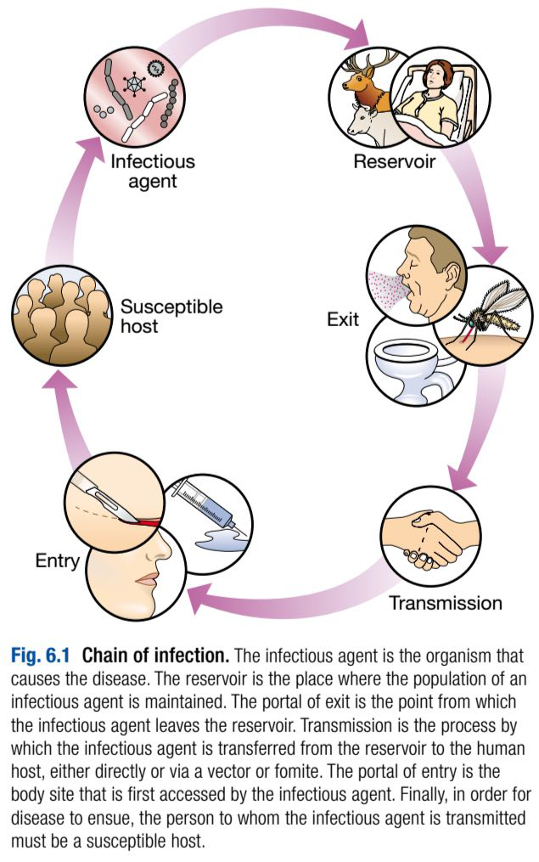
The chain of infection describes six essential elements for communicable disease transmission.

Slide 7
Despite dramatic advances in hygiene, immunisation and antimicrobial therapy, infectious diseases are still responsible for a major global health burden.
Key challenges remain in tackling the diversity of infection in developing countries and the emergence of new infectious agents and of antimicrobial-resistant microorganisms.

Slide 8
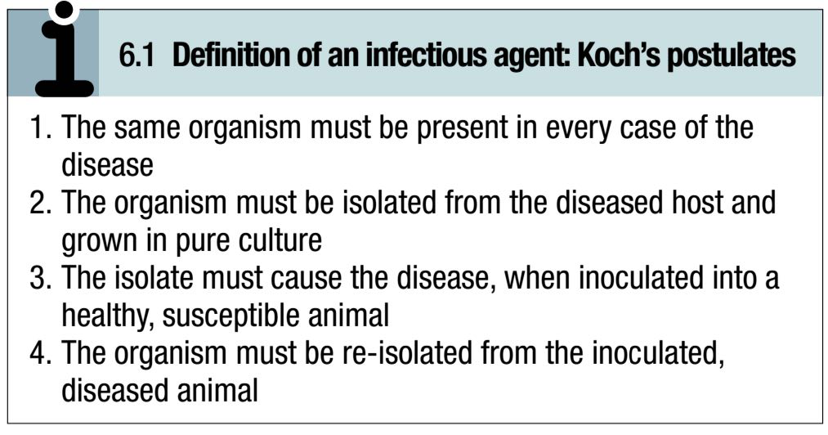
INFECTIOUS AGENTS:
The concept of an infectious agent was established by Robert Koch in the late 19th century.

Slide 9
Although fulfilment of ‘Koch’s postulates’ became the standard for the definition of an infectious agent, they do not apply to organisms which cannot be grown in culture (e.g. Mycobacterium leprae, Tropheryma whipplei) or members of the normal human flora (e.g. Escherichia coli, Candida spp.).

Slide 10
The following groups of infectious agents are now recognised:
1. Prions:
Prions are unique amongst infectious agents in that they are devoid of any nucleic acid.

Slide 11
They appear to be transmitted by acquisition of a normal mammalian protein (prion protein, PrP^{c} ) which is in an abnormal conformation (PrP^{Sc}, containing an excess of beta-sheet protein); the abnormal protein inhibits the enzyme proteasome 26S, leading to a vicious circle of further accumulation of abnormally configured PrP^{Sc} protein instead of normally configured PrP^{c} protein.

Slide 12
The result is accumulation of protein forming amyloid in the central nervous system (CNS), causing transmissible spongiform encephalopathies in humans, sheep, cows and cats.

Slide 13
:2. Viruses
Viruses are incapable of independent replication, instead subverting the cellular processes of host cells.
A virus that infects a bacterium is a bacteriophage (phage).
Viruses contain genetic material (genome), which may be single- or double-stranded DNA or RNA.

Slide 14
Some viruses copy their RNA into DNA by reverse transcription (retroviruses).
The virus genome is enclosed in an antigenically unique protein coat (capsid); together, these form the nucleocapsid.
In many viruses the nucleocapsid is packaged within a lipid envelope.

Slide 15
Enveloped viruses are less able to survive in the environment and are spread by respiratory, sexual or blood-borne routes, including arthropod-based transmission.
Nonenveloped viruses survive better in the environmentand are predominantly transmitted by faecal–oral or, less often, respiratory routes.

Slide 16
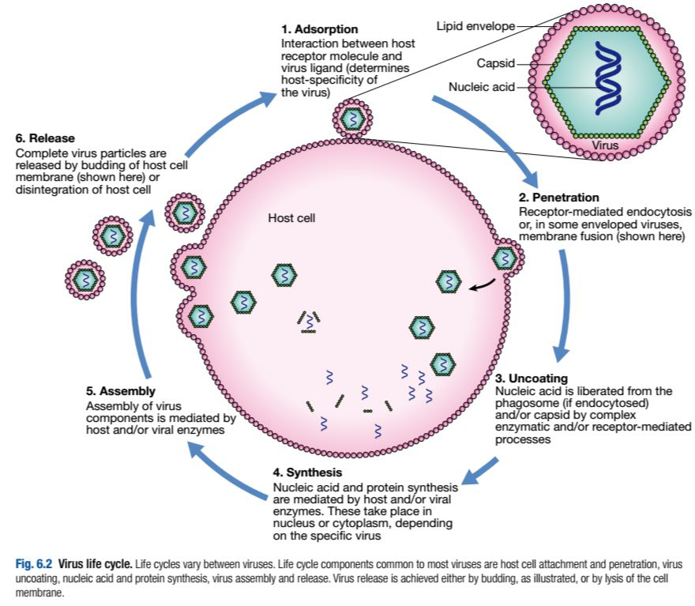

Slide 17
3. Prokaryotes: bacteria (including mycobacteria and actinomycetes)
Prokaryotic cells are capable of synthesising their own proteins and nucleic acids, and are able to reproduce autonomously, although they lack a nucleus.
The bacterial cell membrane is bounded by a peptidoglycan cell wall, which is thick (20–80nm) in Gram-positive organisms and thin (5–10nm) in Gram-negative ones.

Slide 18
The Gram-negative cell wall is surrounded by an outer membrane containing lipopolysaccharide (endotoxin).
Many bacteria contain extra-chromosomal DNA in the form of plasmids, which can be transferred between organisms.
Bacteria may be embedded in a polysaccharide capsule, and motile bacteria are equipped with flagella.

Slide 19
Although many prokaryotes are capable of independent existence, some (e.g. Chlamydia trachomatis, Coxiella burnetii) are obligate intracellular organisms.

Slide 20
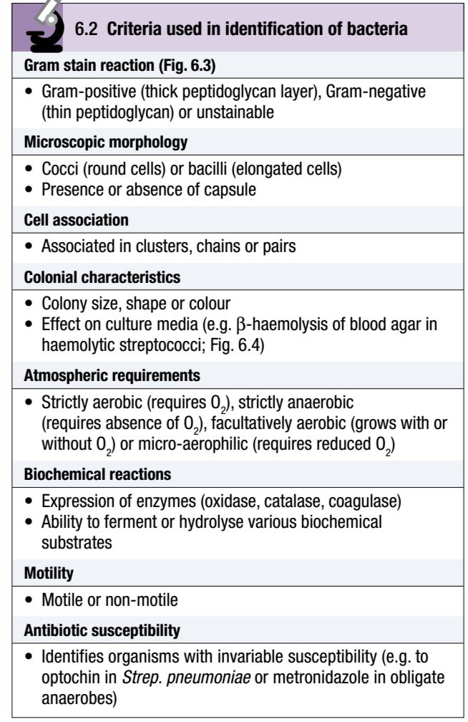
Bacteria that replicate in artificial culture media are classified and identified using a range of characteristics.

Slide 21
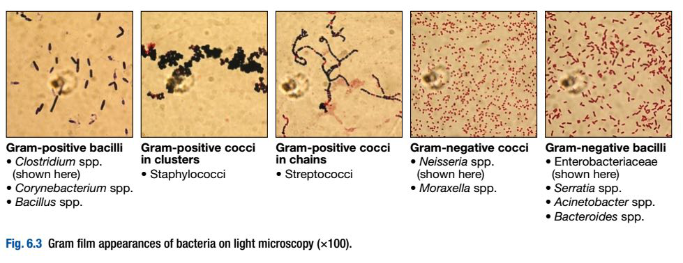

Slide 22
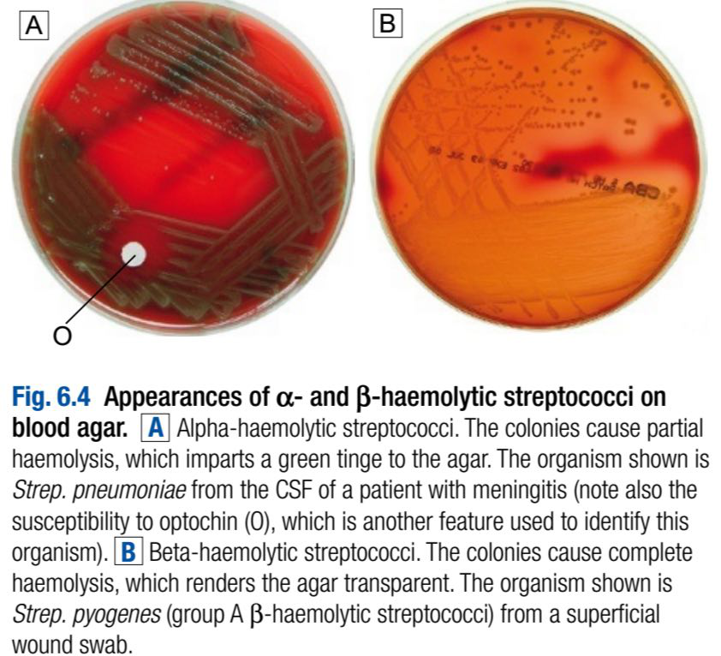

Slide 23
4. Eukaryotes: fungi, protozoa and helminths
Eukaryotes contain functional organelles such as nuclei, mitochondria and Golgi apparatus.
Eukaryotes involved in human infection include fungi, protozoa (unicellular eukaryotes with a flexible cell membrane) and helminths (multicellular complex organisms including nematodes, trematodes and cestodes).

Slide 24
Fungi exist as either moulds (filamentous fungi) or yeasts.
Dimorphic fungi exist in either form, depending on environmental conditions.
The fungal plasma membrane differs from the human cell membrane in that it contains the sterol, ergosterol.

Slide 25
Fungi have a cell wall made up of polysaccharides, chitin and mannoproteins.
In most fungi the main structural component of the cell wall is β-1, 3-D-glucan, a glucose polymer.
Protozoa and helminths are often referred to as parasites.
Many parasites have complex multi-stage life cycles, which involve animal and/or plant hosts in addition to humans.

Slide 26
NORMAL FLORA:
Every human is host to an estimated 10¹³–10¹⁴ colonising microorganisms which constitute the normal flora.
Resident flora are able to survive and replicate at a body site, whereas transient flora are present only for short periods.
Knowledge of non-sterile body sites and their specific normal flora is required to interpret microbiological culture results.

Slide 27
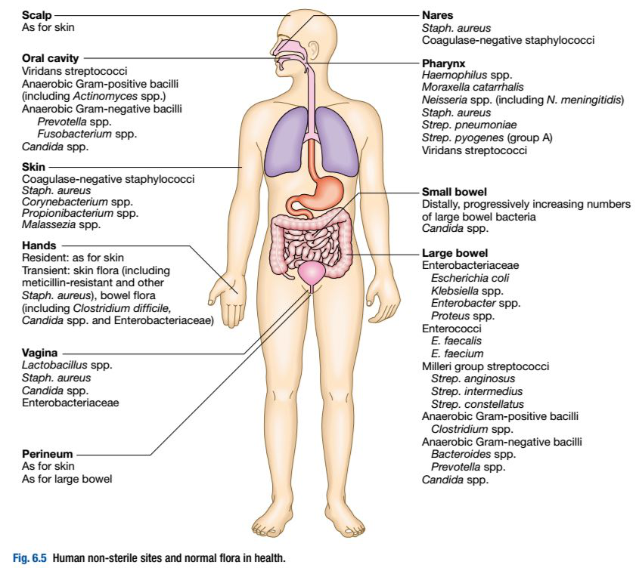

Slide 28
The relationship between human host and normal flora is symbiotic (the organisms are in close proximity) and may be:
• mutualistic (both organisms benefit)
• commensal (one organism benefits whilst the other
derives neither benefit nor harm)
• parasitic (the parasite benefits at the expense of the
host, as in infectious disease).

Slide 29
Maintenance of the normal flora is beneficial to health.
For example, lower gastrointestinal tract bacteria synthesise and excrete vitamins (e.g. vitamins K and B12); colonisation with normal flora confers ‘colonisation resistance’ to infection by pathogenic organisms by altering the local environment (e.g. lowering of pH), producing antibacterial agents (such as bacteriocin peptides, fatty acids and metabolic waste products), and inducing host antibodies which may cross-react with pathogenic organisms.

Slide 30
Conversely it is important to exclude infectious agents from sterile body sites.
The mucociliary escalator transports environmental material deposited in the respiratory tract to the nasopharynx.
The urethral sphincter prevents flow from the non-sterile urethra to the sterile bladder.

Slide 31
Physical barriers, including the skin, lining of the gastrointestinal tract and mucous membranes, maintain sterility of the blood stream, peritoneal and pleural cavities, chambers of the eye, subcutaneous tissue etc.
The normal flora contribute to endogenous infectious disease by either excessive growth (overgrowth) at the ‘normal’ site, or translocation to a sterile site.

Slide 32
Overgrowth is exemplified by ‘blind loop’ syndrome, dental caries and vaginal thrush, in which external factors favour overgrowth of specific components of the normal flora.

Slide 33
Translocation results from spread along a surface or penetration of a closed barrier: for example, in urinary tract infection caused by perineal/enteric flora, and in skin and surgical site infections caused by skin flora such as staphylococci.
Normal flora also contributes to disease by cross-infection, in which organisms that are colonising one individual cause disease when transferred to another more susceptible individual.

Slide 34
HOST–PATHOGEN INTERACTIONS:
Microorganisms capable of causing disease are termed pathogens.
The components of pathogenicity are infectivity (the ability to become established in or on a host) and virulence (the ability to cause harm once established).
Pathogens produce an array of proteins and other factors, termed virulence factors, which interact with host cells to contribute to disease.

Slide 35
• Primary pathogens cause disease in a proportion of individuals to whom they are exposed, regardless of their immunological status.
• Opportunistic pathogens cause disease only in individuals whose natural host defences are compromised, for example, by genetic susceptibility, immunosuppressive disease or a medical intervention.

Slide 36
Characteristics of successful pathogens:
Successful pathogens have a number of attributes.
They compete with host cells and colonising flora by various methods including sequestration of nutrients, use of metabolic pathways not used by competing bacteria, or production of bacteriocins (small antimicrobial peptides/proteins that kill closely related bacteria).

Slide 37
Motility enables pathogens to reach their site of infection, often in sterile sites that colonising bacteria do not reach, such as the distal airway.
Many microorganisms, including viruses, use ‘adhesins’ to attach to host cells at the site of infection.

Slide 38
Other pathogens can invade through tissues.
Pathogens may produce toxins, microbial molecules that cause adverse effects on host cells either at the site of infection or remotely following carriage through the blood stream.
Endotoxin is a cell wall component released mainly following bacterial cell damage and has generalised inflammatory effects

Slide 39
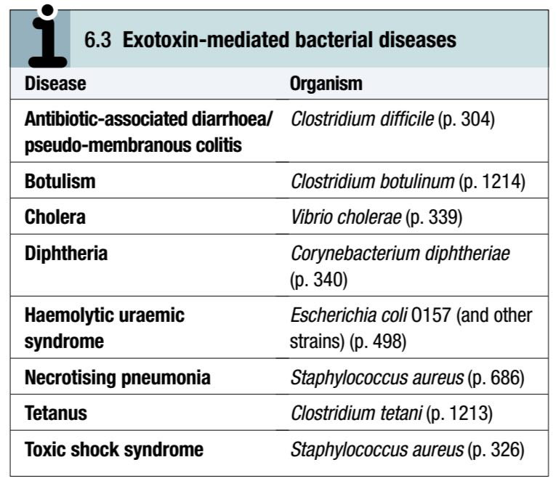
Exotoxins are proteins released by living bacteria, which often have specific effects on target organs.

Slide 40
Intracellular pathogens, including viruses, bacteria (e.g. Salmonella spp., Listeria monocytogenes and Mycobacterium tuberculosis), parasites (e.g. Leishmania spp.) and fungi (e.g. Histoplasma capsulatum), have the capacity to survive in intracellular environments, including after phagocytosis by macrophages.

Slide 41
Pathogenic bacteria express different arrays of genes, depending on environmental stress (pH, iron starvation, O2 starvation etc.) and anatomical location.
In quorum sensing, bacteria communicate with one another to adapt their replication or metabolism according to local population density.

Slide 42
Bacteria and fungi may respond to the presence of an artificial surface (e.g. prosthetic device, venous catheter) by forming a biofilm, which is a population of organisms encased in a matrix of extracellular molecules.
Biofilm-associated organisms are highly resistant to antimicrobial agents.

Slide 43
Genetic diversity enhances the pathogenic capacity of bacteria.
Some virulence factor genes are found on plasmids or in phages and are exchanged between different strains or species.
The ability to acquire genes from the gene pool of all strains of the species (the ‘bacterial supragenome’) increases diversity and the potential for pathogenicity.

Slide 44
Viruses exploit their rapid reproduction and potential to exchange nucleic acid with host cells to enhance diversity.
Once a strain acquires a particularly effective combination of virulence genes, it may become an epidemic strain, accounting for a large subset of infections in a particular region.
This phenomenon accounts for influenza pandemics.

Slide 45
The host response:
The human host relies on innate and adaptive immune and inflammatory responses to control the normal flora and respond to pathogens.

Slide 46
Pathogenesis of infectious disease:
The harmful manifestations of infection are determined by a combination of the virulence factors of the organism and the host response to infection, both of which vary at different stages of disease.
Despite the obvious benefits of an intact host response, an excessive response is undesirable.

Slide 47
Cytokines and antimicrobial factors contribute to tissue injury at the site of infection, and an excessive inflammatory response may lead to hypotension and organ dysfunction.
The importance of the immune response in determining disease manifestations is exemplified in immune reconstitution inflammatory syndrome (IRIS, or immune reconstitution disease).

Slide 48
In this condition—seen, for example, in HIV infection, neutropenia or tuberculosis (which causes suppression of T-cell function)—there is a paradoxical worsening of the clinical condition as the immune dysfunction is corrected.

Slide 49
The febrile response:
Thermoregulation is altered in infectious disease.
Microbial pyrogens or the endogenous pyrogens released during tissue necrosis stimulate specialised cells such as monocytes/macrophages to release cytokines including IL-1β, tumour necrosis factor (TNF)-α, IL-6 and IFN-γ.

Slide 50
Cytokine receptors in the pre-optic region of the anterior hypothalamus activate phospholipase A, releasing arachidonic acid as substrate for the cyclo-oxygenase pathway and producing prostaglandin E2 (PGE2), which in turn alters the responsiveness of thermosensitive neurons in the thermoregulatory centre.

Slide 51
Rigors occur when the body inappropriately attempts to ‘reset’ core temperature to a higher level by stimulating skeletal muscle activity and shaking.
The role of the febrile response as a defence mechanism requires further study, but there are data to support the hypothesis that raised body temperature interferes with the replication and/or virulence of pathogens.

Slide 52
THE END

